Slide 1
$group

Slide 2
$group
$group returns one document for each unique value of the ”_id” expression.
For each Group, we can calculate aggregate functions such as counts, sums, averages, etc.
$group is roughly equivalent to the SQL GROUP BY statement

Slide 3
High level syntax
The “GROUP BY”
{$group:{_id:{expression},
newField1:{accumulator:expression},
newField2:{accumulator:expression},
…
}}
The aggregations

Slide 4
Accumulators
Operator | Description
$avg | Returns the average of the value for each group
$count | Returns the count of the value for each group
$max | Returns the maximum of the value for each group
$min | Returns the minimum of the value for each group
$sum | Returns the standard deviation of the value for each group

Slide 5
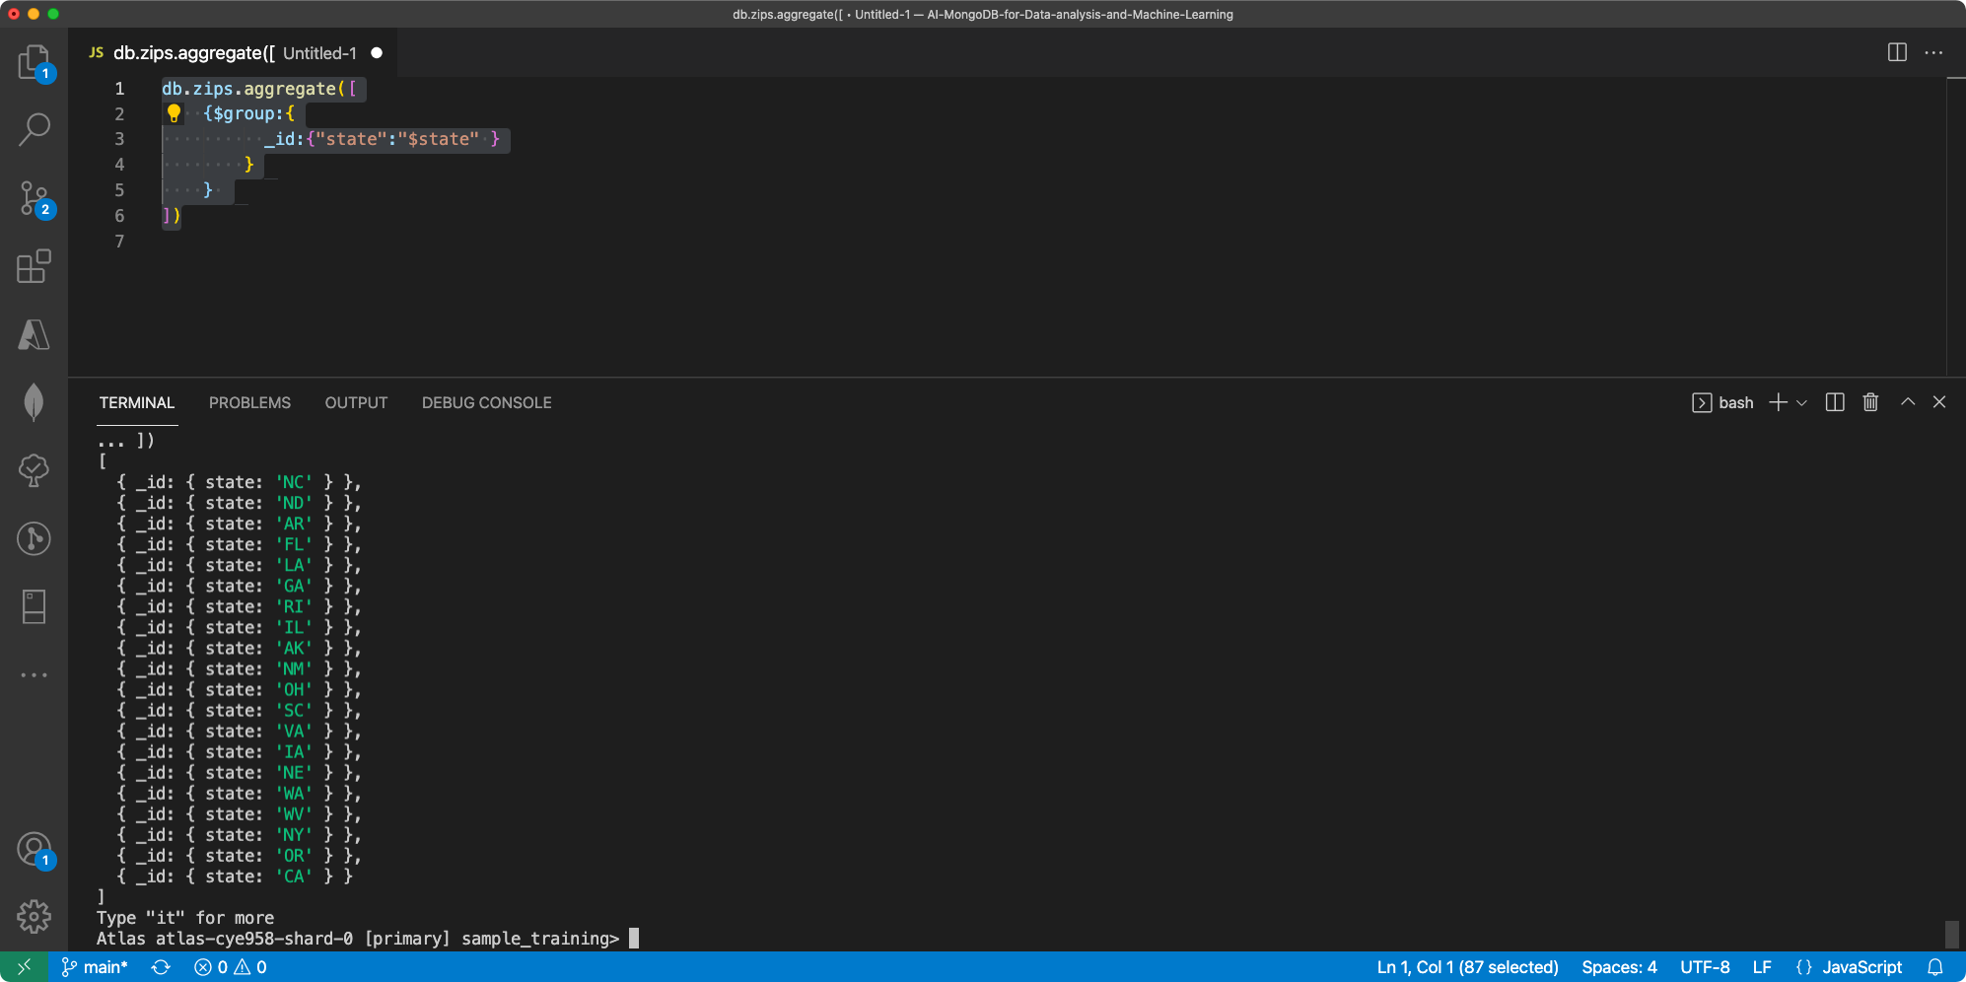
Value from previous stage
Value passed to next stage

Slide 6
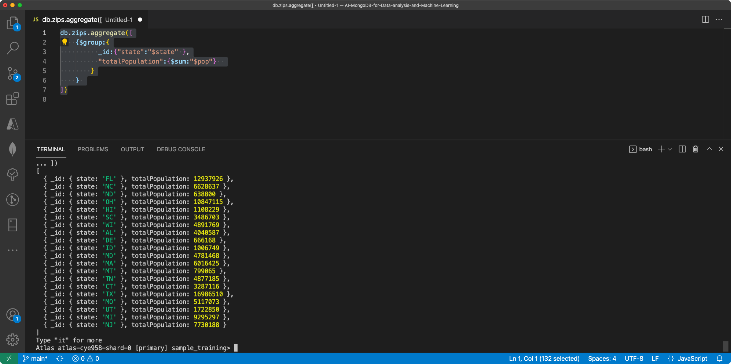

Slide 7
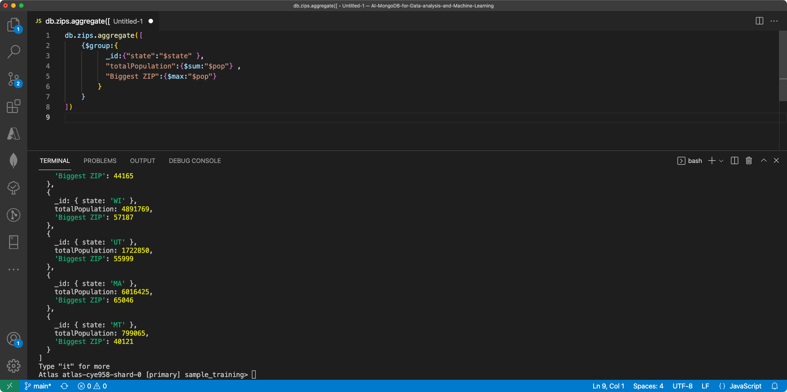

Slide 8
$match and $group together
We can use $match to limit the data passed INTO $group
OR, exclude certain groups
When we can, we should place $match BEFORE, since it reduces the overhead.

Slide 9
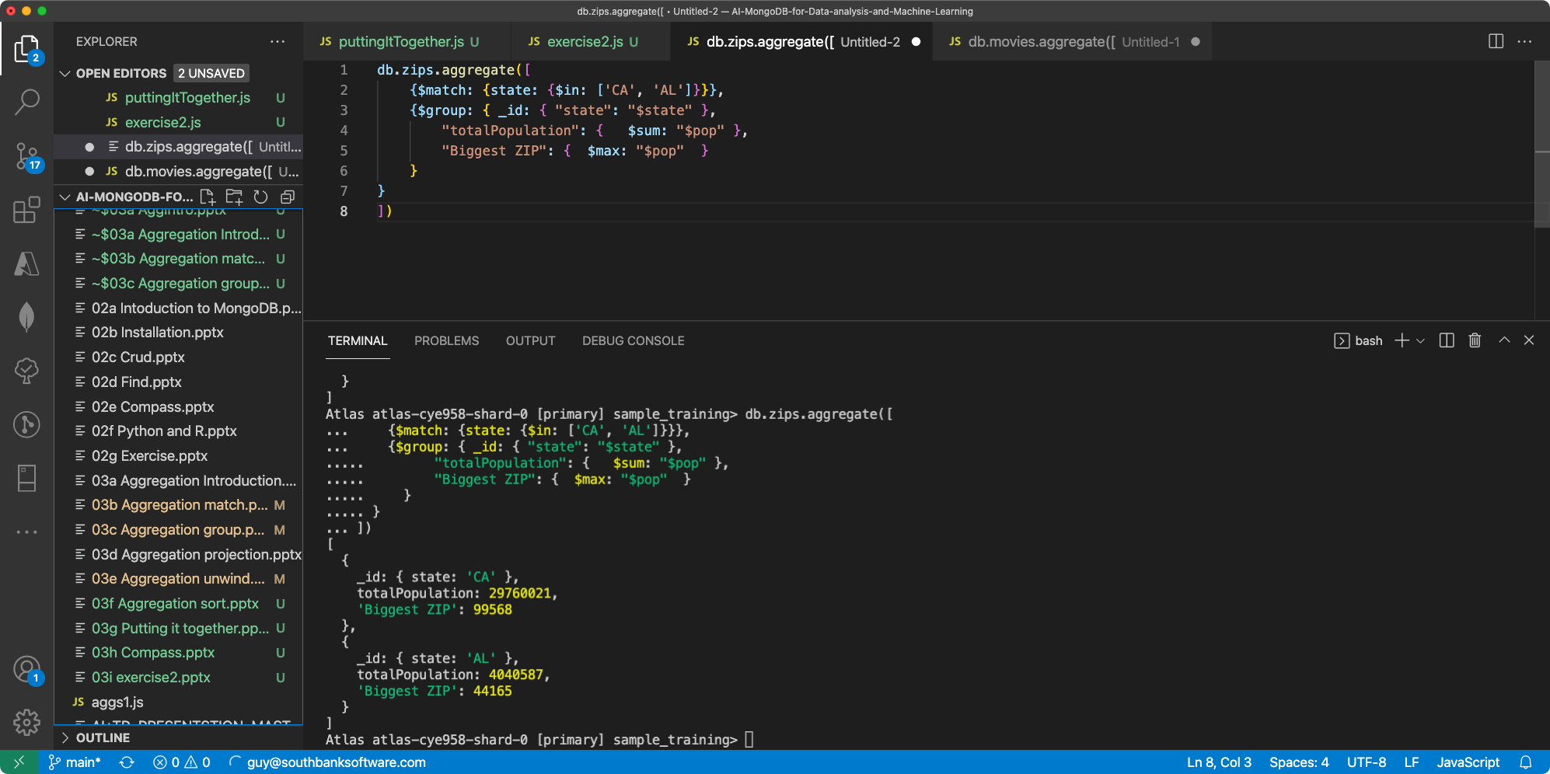

Slide 10
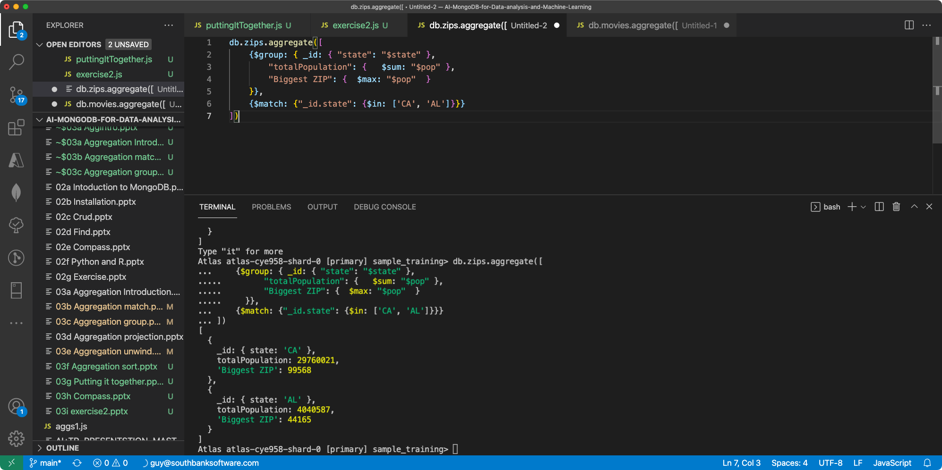

Slide 11
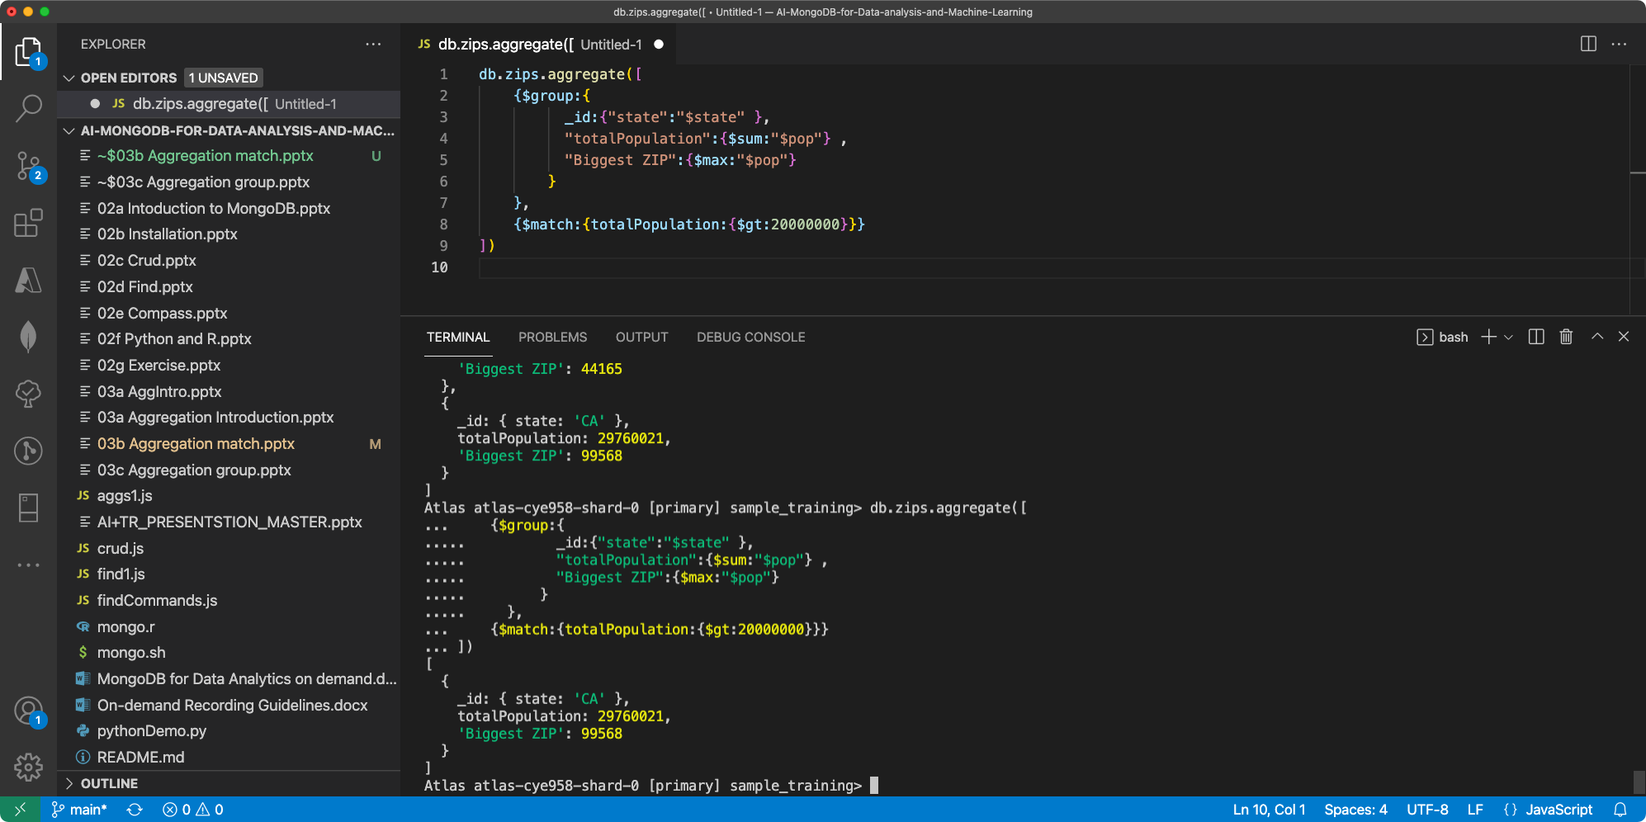

Slide 12
Grouping by multiple attributes

Slide 13
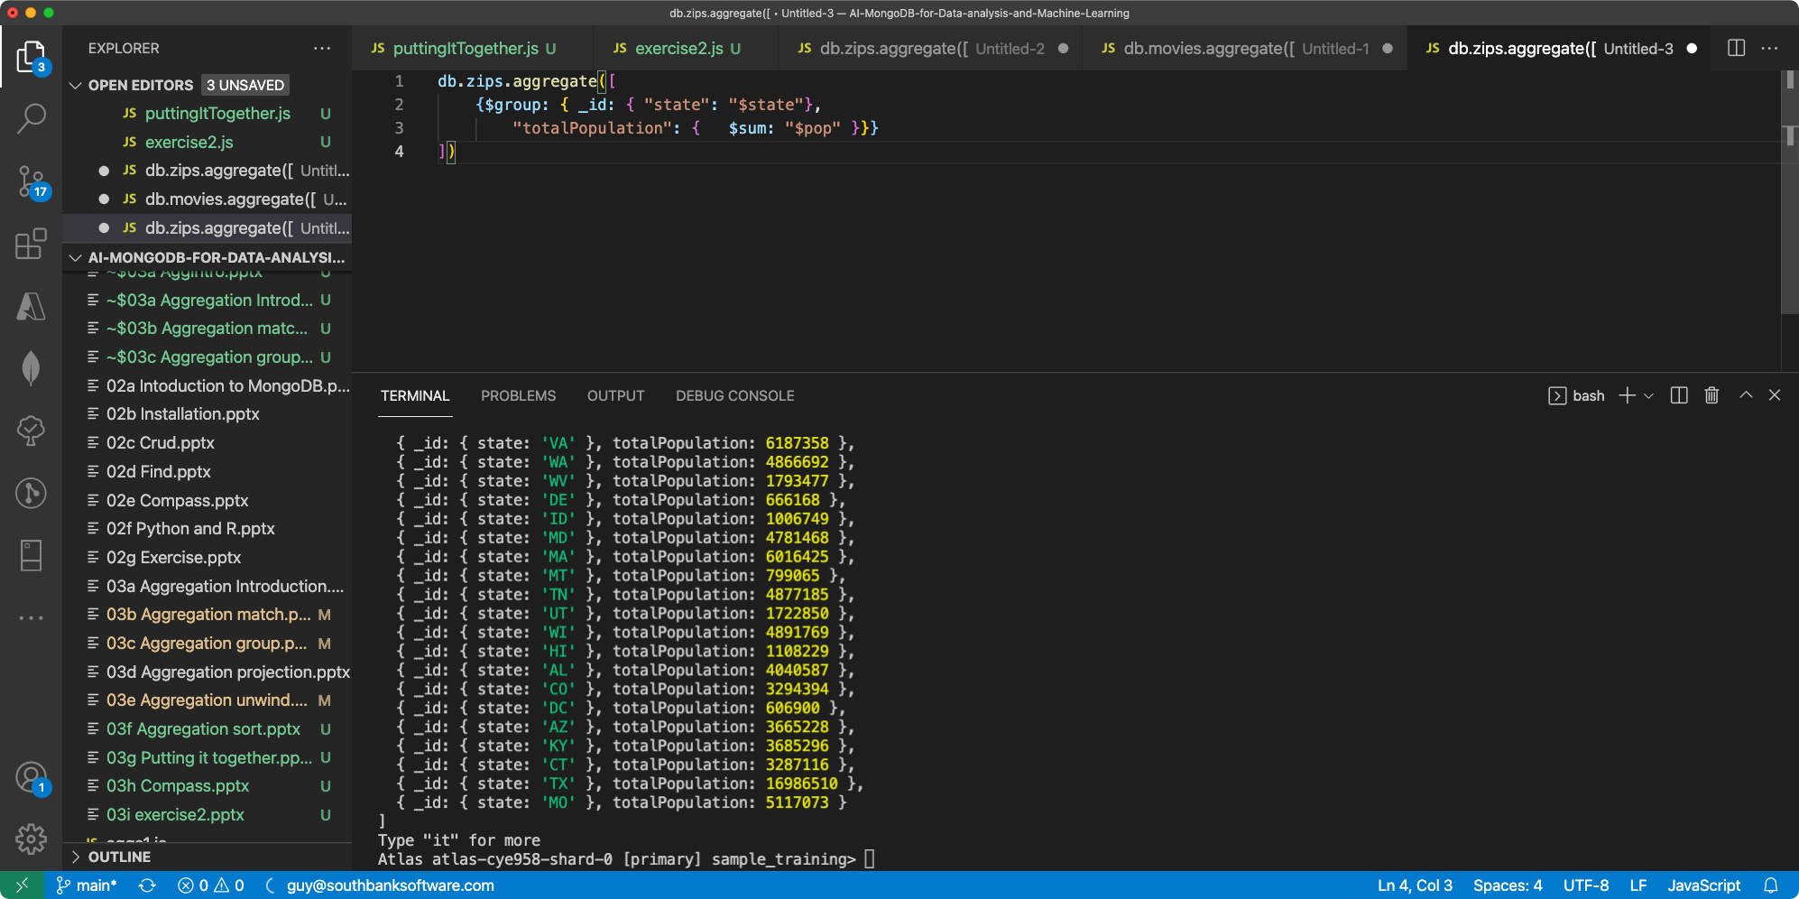

Slide 14
